Slide 1

BUSINESS ANALYSIS 1B
LEARNING UNIT 5 – ANALYSING AND MANAGING STAKEHOLDERS
Notes:
Business Analysis Fourth edition
Author: Debra Paul and James Cadle
Publisher: The Chartered Institute of IT
PDF ISBN: 978-1-78017-5119
Chapter 6 (P.g 144 - )

Slide 2
IMPORTANT INFORMATION
LEARNING UNIT | FORMATIVE ACTIVITY DESCRIPTION | ASSESSMENT WEIGHTING | DATE
Based on each learning unit done each week | Weekly quiz/ Tuts test | 16% | ------
LU 1 – LU2 | Group Assignment 1 | 10% | 08 Aug
LU1 – LU4 | Group Assignment 2 | 10% | 15 Sept
LU5 – LU7 | Group Assignment 3 | 15% | 14 Oct
LU1 – LU4 | Individual Test 1 | 12% | 21 Aug
LU5 – LU7 | Individual Test 2 | 12% | 2 Oct
LU1 – LU7 | Deferred/ Makeup Assessment | ----- | 16 Oct
LU1 – LU7 | Final Individual Assessment | 25% | 31 Oct

Slide 3
LEARNING OUTCOMES
Define and explain the concept of stakeholders
Identify and categorise stakeholders
Apply stakeholder analysis techniques
Evaluate stakeholder management strategies
Assess the role of social media and modern communication tools

Slide 4
ANALYSIS AND MANAGING STAKEHOLDERS
Effective stakeholder management is crucial to the success of any business analysis project.
Knowing who the stakeholders are, and understanding what it is they expect from the project and delivered solution is vital if they are to remain involved and supportive of the business changes.
One of the major reasons why business analysis projects do not succeed - or do not succeed fully - is poor stakeholder management.
For example, a project team may not recognise the importance, or even the existence, of a key stakeholder and accordingly may find that their plans are constantly frustrated.
If the relevant stakeholders are identified and managed properly, most obstacles can be cleared.
Notes:
Much of the groundwork for stakeholder management takes place during project initiation and inception, and this work must be revisited constantly as the project progresses.

Slide 5
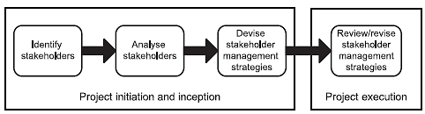
ANALYSIS AND MANAGING STAKEHOLDERS
Stakeholder management in the project lifecycle
Notes:
The main responsibility for stakeholder management may rest with the project manager or with a senior business analyst.
However, all team members have important roles to play in identifying stakeholders, in helping to understand their needs and by helping to manage their expectations of the project.

Slide 6
STAKEHOLDER CATEGORIES
The first step in stakeholder management involves finding out who the stakeholders are.
A good working definition of a stakeholder is: anyone who has an interest in, or may be affected by, the issue under consideration.
This means, more or less, anyone affected by the project or who may be in a position to influence it.
Each project has its own distinctive set of stakeholders, determined by the nature of the project and the environment in which it is taking place.
However, some 'generic' stakeholder categories can be identified that may apply to many projects.

Slide 7
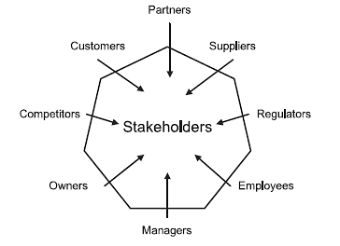
STAKEHOLDER CATEGORIES
The stakeholder wheel

Slide 8
STAKEHOLDER CATEGORIES
Customers
These are the people or organisations for whom the organisation provides products or services.
They are stakeholders because anything done in the way of change has a potential effect on them.
The project team must consider how to manage that change most effectively so as not to lose customers that they wish to retain.
It may be useful to subdivide the term ·customer' into specific
categories, such as:
large or small; regular or occasional; wholesale or retail; corporate or private; commercial, non-profit or public-sector; civilian or military; domestic or export.

Slide 9

STAKEHOLDER CATEGORIES
Partners
These are the organisations that provide specialist services to the organisation or work on its behalf.
Examples of partner organisations may be a reseller of products or services, or an outsourcing company that provides catering services.

Slide 10
STAKEHOLDER CATEGORIES
Suppliers
These provide the organisation with the goods and services that it uses. They may be subdivided into the following categories:
major or minor;
regular or occasional;
domestic or overseas.
Suppliers are stakeholders because they are interested in the way the organisation does business with them, what it wishes to buy, how it wants to pay and so on.
Many change initiatives have the effect of altering the relationships of organisations with their suppliers and, as with the customers, such changes need to be managed carefully to make sure that they achieve positive and mutually beneficial results.

Slide 11

STAKEHOLDER CATEGORIES
Regulators
Many organisations are now subject to regulation or inspection by external authorities.
Regulators are concerned that any changes proposed by an organisation comply with the rules they enforce.
For example, laws and regulations that govern an organisation's financial conduct, or professional standards, such as those required of the medical profession.

Slide 12

STAKEHOLDER CATEGORIES
Employees
The people who work in an organisation clearly have an interest in the way it is run and in changes that it makes.
In a small firm, the employees may be regarded as individual stakeholders in their own right but, in larger organisations, they are probably best considered as groups.
Sometimes, employees belong to trades unions, whose officials therefore become stakeholders too.

Slide 13
STAKEHOLDER CATEGORIES
Managers
There are also the professional managers of the organisation, those to whom its direction is entrusted.
In a large organisation, there may be many layers of management, and each may form a distinctive stakeholder grouping, for example:
board-level senior managers;
middle managers;
junior managers;
front-line supervisors.
As with many aspects of stakeholder management, it is an error to assume that a group is homogeneous in its views and concerns; junior managers may well have a very different perspective, and a different set of values and priorities, from those on the Board who take the major strategic decisions.

Slide 14

STAKEHOLDER CATEGORIES
Owners
For a commercial business, the owners are just that - the people who own it directly.
The business may be, in legal terms, a sole trader or partnership, or it could be a limited company, in which case the owners are the shareholders.
For public limited companies, the majority of shares are held by institutions such as investment companies and pension funds, and so the managers of these share portfolios become proxy owners.

Slide 15
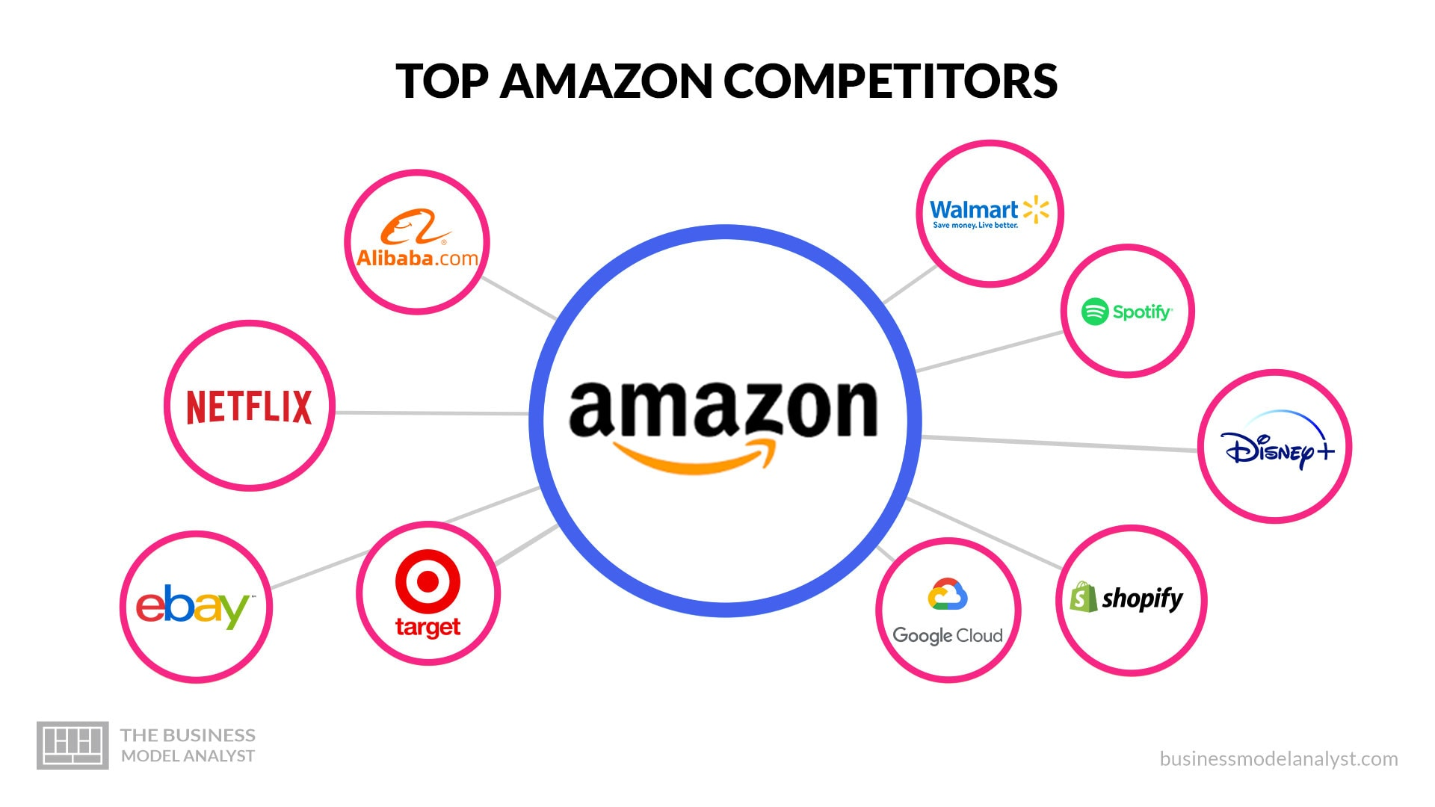
STAKEHOLDER CATEGORIES
Competitors
Competitors compete with the organisation for the business of its customers.
Therefore, they have a keen interest in any changes made by an organisation.
Their reactions to any changes have to be considered; for example, how a competitor might react and whether they might try to block an initiative or produce a form of counterproposal.

Slide 16
STAKEHOLDER CATEGORIES
Other stakeholders
For example, the insurers of an organisation may be interested in any areas that could affect the pattern of risk that is covered.
Alternatively, the police might be interested in the law and order implications of some actions.
In some organisations, the views of staff associations are also significant.
It is important for each project that the identification of stakeholders is as complete as possible, as it will otherwise be impossible to develop and implement effective management strategies for them.
It may be useful to conduct some sort of workshop with people knowledgeable about the organisation and the proposed project to make sure that the coverage of stakeholders is comprehensive.

Slide 17
ANALYSISNG STAKEHOLDERS
Having identified the stakeholders, the next step is to make an assessment of the weight that should be attached to their issues.
No stakeholder should be ignored completely, but the approach to each will be different depending on
(i) their level of interest in the project and
(ii) the amount of power or influence they wield to further or obstruct it
The power/interest grid (adapted from Newcombe, 2003), shown in the next Figure, offers a useful technique for analysing stakeholders.

Slide 18
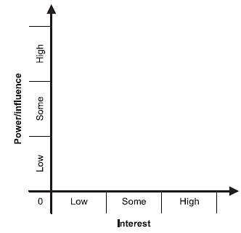
ANALYSISNG STAKEHOLDERS
In using the power/interest grid, it is important to plot stakeholders where they actually are, not where they should be.
Strategies can then be explored for managing them in their positions or, perhaps, for moving them to other positions that might be more advantageous for the success of the project

Slide 19
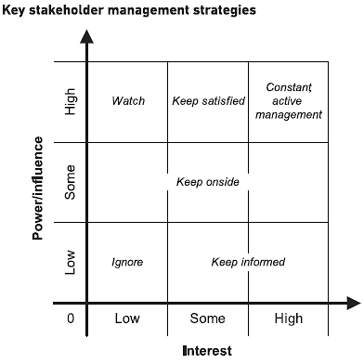
STAKEHOLDER MANAGEMENT STRATEGIES
There are many positions that could be taken on the power/interest grid, but it is usually sufficient to consider the nine combinations of power and interest illustrated in Figure below.

Slide 20
STAKEHOLDER MANAGEMENT STRATEGIES
No or low interest and no or low power/influence
These are stakeholders who have neither a direct interest in the project nor any real power to affect it.
For practical purposes. They can be ignored as regards day-to-day issues on the project, and there needs to be no special effort made to 'sell' them its benefits.
However, as stakeholders do change positions on the grid (see below), it is usually wise to inform them occasionally about progress and the latest position.
A periodic newsletter can be a helpful mechanism for these updates.

Slide 21
STAKEHOLDER MANAGEMENT STRATEGIES
Some or high interest but no or low power/ influence
These groups can be very difficult to manage effectively, as they may be very directly affected by a change project, they feel powerless to shape its direction in any way.
This can result in frustration and a sort of passive resistance to change. Though overcome by positional power, it can lead to delay and less-than-optimal results.
The management strategy for these stakeholders is to keep them informed of what is going on and of the reasons for the proposed change.
However, this can be a rather passive approach and, in many circumstances, more effort should be devoted to 'selling' the benefits of the project.
Notes:
This can best be done by being as honest as possible about the need for change, and highlighting the positive aspects of the change and the negative consequences of not making them. Frequent and focused communication regarding progress is also necessary when managing these stakeholders.

Slide 22
STAKEHOLDER MANAGEMENT STRATEGIES
No or low to high interest, but some power/influence
This includes some stakeholders like middle or senior managers who do have some power or influence, but, because their interests are not directly affected, are not very concerned about the direction a project is taking.
Regulators may also fall into this category, although they will only become involved if there is a suspected breach of their rules.
This group can also include those with a higher level of interest in the project but who have only limited power or influence.
The best approach with this group is to keep them supportive of the project, possibly by issuing frequent information updates to them, and also by increasing their involvement with the project.

Slide 23
STAKEHOLDER MANAGEMENT STRATEGIES
No or low interest but high power/influence
These are probably very senior managers who, for one reason or another, have no direct interest in the project.
This may be because it is too small or unimportant for them to bother with, or it may be that it is in an area that doesn't interest them.
For example, the marketing director for an organisation is unlikely to be concerned about a project to streamline the stationery purchasing procedures, and it may be assumed that this stakeholder can be ignored.
However, this is actually a rather risky approach. The marketing director may become very interested in the stationery procurement system if items such as pens or sticky notes are unavailable in time for an important meeting or conference.
Notes:
Where a situation arises that might cause these stakeholders to take a greater interest in the project, it might be prudent to address their needs directly, possibly via one-to­ one meetings, in order to ensure that they do not start to raise concerns or even decide to exert their influence.
In some situations, the project team may wish to encourage the increased interest of influential stakeholders, for example, if it was felt that their support would help achieve the project objectives.
Where this is the case, it may be necessary to highlight any aspects of the project that have a direct impact upon the stakeholder's business area; some form of discussion will be required that. with very influential stakeholders, would typically involve a meeting.

Slide 24
STAKEHOLDER MANAGEMENT STRATEGIES
Some interest and high power/influence
These stakeholders have some interest in the project. and they have actual power over what happens.
The key strategy to manage these stakeholders is to keep them satisfied, so that they do not take a more direct (and hence, possibly, more obstructive) interest in the project.
However, in some circumstances, the strategy may be to encourage these stakeholders to become more actively involved in a project.
For example, if the finance director for an organisation can be persuaded to be positively involved in a project.
They may be a powerful force for success, since they can make resources available that would otherwise be hard to obtain.

Slide 25
STAKEHOLDER MANAGEMENT STRATEGIES
High interest and high power/influence
These stakeholders have some interest in the project. and they have actual power over what happens.
The key strategy to manage these stakeholders is to keep them satisfied, so that they do not take a more direct (and hence, possibly, more obstructive) interest in the project.
However, in some circumstances, the strategy may be to encourage these stakeholders to become more actively involved in a project.
For example, if the finance director for an organisation can be persuaded to be positively involved in a project.
They may be a powerful force for success, since they can make resources available that would otherwise be hard to obtain.

Slide 26
STAKEHOLDER MANAGEMENT STRATEGIES
High Interest and high power/influence
These are the key players, the people who are both interested in the project and have the power to make it work or not.
Often, the key players are the managers of the functions involved in a project.
Initially, it is important to determine if individual key stakeholders are positive or negative in their approach to a project. If positive, then their enthusiasm must be sustained, especially during times of difficulty.
It is also important to appreciate the concerns and opinions of key stakeholders, and these will need to be taken into account when making any recommendations.
Notes:
For example, if one of the key stakeholders has a particular solution in mind, it is important to know about this as early as possible in order to ensure that, at the very least, the solution is evaluated as one of the options.
It is also vital that the key stakeholders understand the progress of the project and why certain decisions have been made.
These are the people to whom any final recommendations will be presented and who will have the final say on any decisions. They need to be
kept informed at all stages of the project so that none of the recommendations come as a shock to them.
Those key players who are negatively inclined towards a project can be managed in various ways, depending on the circumstances:
By far the best approach is to find some personal benefits for them in the proposed course of action.
The stakeholder perspective analysis techniques described later in this chapter can be very useful here.
Alternatively, a more powerful counterforce must be found to outweigh their negative influence. This may mean engaging the interest of someone in one of the high-power areas of the grid.

Slide 27
STAKEHOLDER MANAGEMENT STRATEGIES
Individuals and groups of stakeholders
An individual customer may not be of much concern to an organisation such as a big supermarket chain.
But if they post a negative review using social media, write to newspapers, organise petitions or complain to consumer groups, they can increase their level of power considerably.
A lot of 'people power· can damage even large organisations considerably and force them into major reversals of course.
The classic business example of this concerns the case from the 1980s when Coca-Cola was impelled to reintroduce its traditional drink formula in the face of a massive worldwide customer revolt against a new formula.
Notes:
Similarly, individual employees can be marginalised by an organisation. if they are members of a trade union, their power is greater.
A single government employee who objects to a policy may be relatively powerless, but if they 'blow the whistle' to national newspapers, they can cause considerable difficulty.
These examples illustrate the dangers of ignoring the weakness of an individual or mistaking individual weakness for collective weakness.
Stakeholders must be considered not just as individuals but as potential groups as well. Their ability to gain strength, particularly with the availability of social media mechanisms, should never be underestimated.

Slide 28
MANAGING STAKEHOLDERS
Stakeholders' positions do not remain static during the life of a project.
For example, a manager may be promoted and move from being in a high-interest/low-power situation to becoming both interested and powerful.
Alternatively, the manager may lose interest in a project if promoted into a job with a wider remit. The circumstances of an organisation may change so that senior managers begin to focus more or less on IT projects.
A scandal within a competitor organisation may cause a regulator to take a closer interest in all companies in a sector.

Slide 29
MANAGING STAKEHOLDERS
This means that stakeholder analysis must be a continuing activity throughout the project - and even afterwards, to find out what the stakeholders thought of the final outcome.
The project team and project manager should be constantly on the lookout for changes in stakeholders' positions and should re-evaluate their management strategies accordingly.
Once stakeholders' initial positions have been plotted, a plan should be drawn up for managing each of them and how to approach them.

Slide 30
MANAGING STAKEHOLDERS
A one-page assessment can be made for each stakeholder, but a more useful approach would be to see all stakeholders at a glance by setting up a spreadsheet with the following headings:
Name of stakeholder: It may also be useful to record their current job title(s).
Current power/influence: From the power/interest grid.
Current interest: From the power/interest grid.
Issues and interests: This is a brief summary of the interests each stakeholder is thought to have and what are believed to be their main issues with the project.

Slide 31
MANAGING STAKEHOLDERS
Current attitude: A classification scheme is needed to determine the attitude of a particular stakeholder. The following categories may be used:
Champion: will actively work for the success of the project.
Supporter: in favour of the project but probably will not be very active in promoting it.
Neutral: has expressed no opinion either in favour or against the project.
Critic: not in favour of the project but probably not actively opposed to it.
Opponent: will work actively to disrupt, impede or derail the project.
Blocker: someone who will just obstruct progress, possibly for reasons outside the project itself.

Slide 32
MANAGING STAKEHOLDERS
Desired support: This is the level of support that would be useful from this stakeholder. A basic scale of high, medium or low may suffice to indicate the desired level of support.
Desired role: It can be useful to clarify the role to be undertaken by a stakeholder. For example, by providing a definition of the role and responsibilities of the business representatives on the project. Desired actions: These are the actions that stakeholders should carry out, where possible, in order to benefit or advance the project.
Messages to convey: This is where the emphasis to be put on any communications to this stakeholder is defined.
Actions and communications: This is the most important part of the plan, where the actions to be taken with regard to this stakeholder are defined. It may be just to keep them informed, in a positive way, about the project and progress to date.

Slide 33

SOCIAL MEDIA AND STAKEHOLDER MANAGEMENT
Social media can be an integral part of a stakeholder communication and management strategy.
In addition to publicly available platforms, such as LinkedIn and X (Twitter), there are several software products that are used primarily for organisation-specific communications.
These products support a wide variety of functions, including direct instant messaging, collaborative working, online meetings, and audio and video recording.
Some products offer shared document and knowledge repositories, typically with cloud storage facilities.

Slide 34
SOCIAL MEDIA AND STAKEHOLDER MANAGEMENT
Often, the communication approach taken within social media is less formal than traditional communication methods.
As with other communications, though, care should be taken to consider the desired outcome and the appropriateness of the content and format of the communication.
For example, putting sensitive or confidential information onto public or social media messaging boards, whether external or internal to the organisation, is likely to risk negative consequences.
If, in contrast, the messaging boards are used to provide appropriate, useful, timely and accurate updates, such as on the progress of a change initiative, this may have a positive effect.

Slide 35
SOCIAL MEDIA AND STAKEHOLDER MANAGEMENT
Care should be taken when considering conducting research into stakeholders through publicly available social media platforms.
For example, reviewing an individual's personal photographs and messages is likely to be deemed intrusive.
That said, researching an individual through company websites and professional networking platforms may be helpful in providing a context and background for the person and may provide insight into an individual's role, professional interests, network and career history.

Slide 36
LEARNING OUTCOME REVIEW
Now that you have finished the chapter please review the learning outcomes in your text

